Slide 1
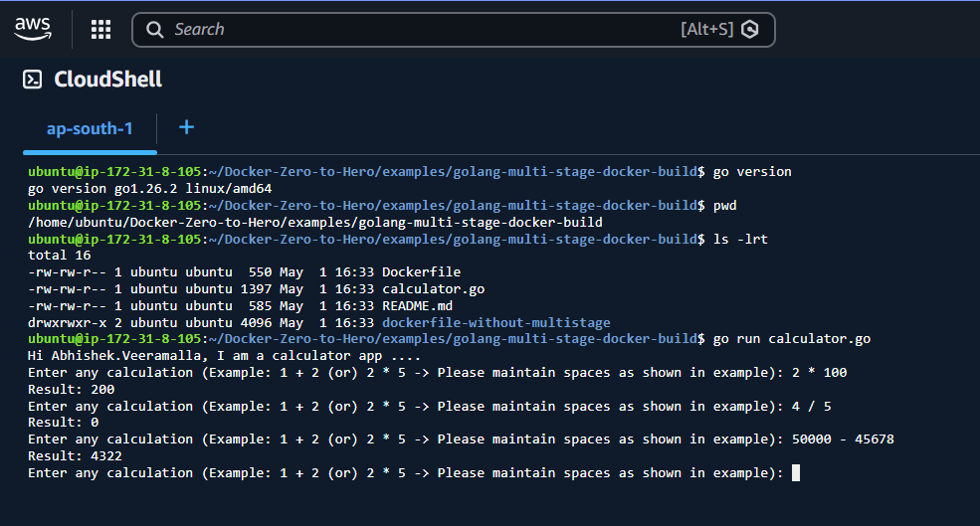

Slide 2
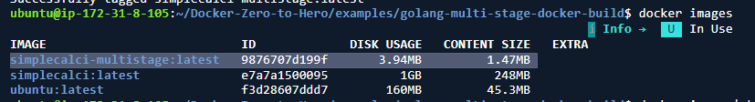
Without Multistage – 248 MB
After building with Multistage – 1.47 MB

Slide 3
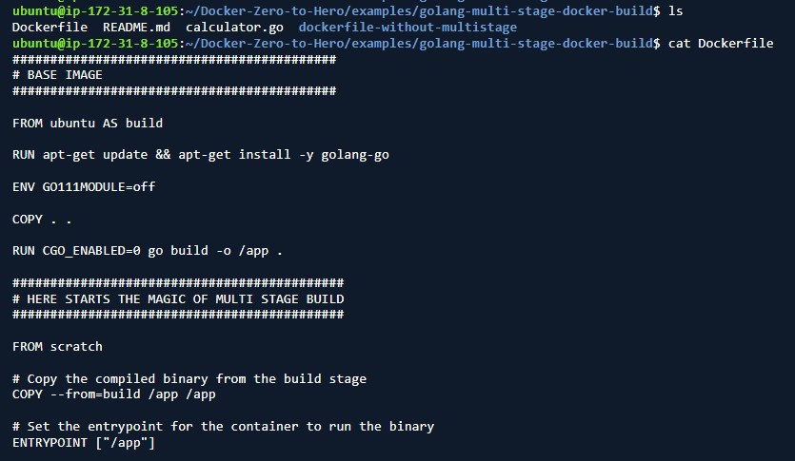
Docker file with Multistage

Slide 4
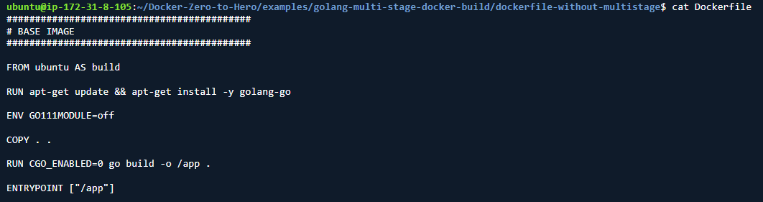
Docker file without Multistage

